Slide 1

EMPLOYEE ATTRITION PREDICTION
Dissertation PRESENTATION (10575665 Group - A) Devendra Kulkarni

Slide 2

INTRODUCTION
The phenomena of employee attrition is one of the most well-known issues in human resource management. This occurs when an individual decides to quit his position for a variety of personal and professional reasons. When a well-trained and adaptable human resource quits the organization, it is quite difficult to fill the void immediately. As a result, it has a direct influence on the group's efficiency. So, it is necessary to find the predictive measures to avoid this scenario. Thanks to the different Machine Learning approaches, applying those on the company’s dataset we can easily tackle this problem.

Slide 3

UNDERSTANDING THE PROBLEM
Business Problem
Employee attrition is an issue that we cannot eliminate since it occurs often for a variety of reasons. Some variables are beyond anyone's control. For example, if an employee decides to leave the company for emotional or other reasons, such as relocating to a new city after marrying. Using the right predictive model, on the other hand, may help you achieve the best results for controlling the staff turnover rate.
Research Problem
It is critical for any organization to meet the needs of its personnel. Because an employee is the most important factor in the smooth running of any business. Therefore, establishing a prediction by researching or polling their employees to find any process improvements would avoid any effect on the firm's performance. CRISP-DM technique was used in the research to create a consistent foundation for the whole project's development.

Slide 4
FINDING THE SOLUTIONS
Research Questions:
• What are the implications of employee attrition for any company, and what are some probable causes?
• How well can staff attrition be handled when relevant predictive modelling tools such as Logistic Regression SVM, KNN, and Decision Tree are used?
Research Contribution
This technique might be quite beneficial to the human resources management team. Because they may tailor their recruiting process to match the demands of their employees to retain them if they obtain an analysis of the employee attrition prediction report well in advance. With the help of different machine learning algorithms, it will certainly give the best suitable algorithm for the dataset.

Slide 5
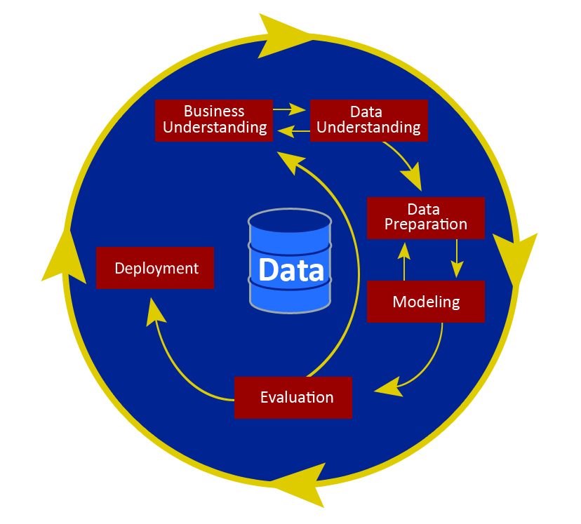
USING CRISP-DM METHODOLOGY

Slide 6

BUSINESS UNDERSTANDING
The major focus of the business knowledge phase is understanding the project's goals and demands. My project's goal is to discover the reasons why employees quit a company with or without serving their notice period. With that understanding, the aim is to deliver the best answer to this problem feasible.

Slide 7

DATA UNDERSTANDING
The second step is data understanding, and its objective is to grasp what may be acquired and expected from the data. It investigates the reliability of the data. Knowing data is being aware of its presence, the needs it will serve, its position, and its content. The data-understanding phase consists of four tasks. Which are:
• Data collection
• Data description
• Data analysis
• Data quality assessment

Slide 8

DATA PREPARATION
The most important stage in the building of any model for analysis is data pre-processing. We can't prevent the anomalies unless the dataset is cleansed. Processing unclean data will result in poor accuracy and performance scores. Data pre-processing is simply the removal of null values from the dataset, the deletion of extraneous data, and the conversion of raw data into a usable format. However, various complications might arise during processing the dataset for pre-processing, such as erroneous data types, numerical units, missing data, and so on. It is critical to validate for clean datasets regardless of any difficulties that may develop during data pre-processing. This may be done by converting the dataset into a standardized format that the various machine learning algorithms can process.

Slide 9
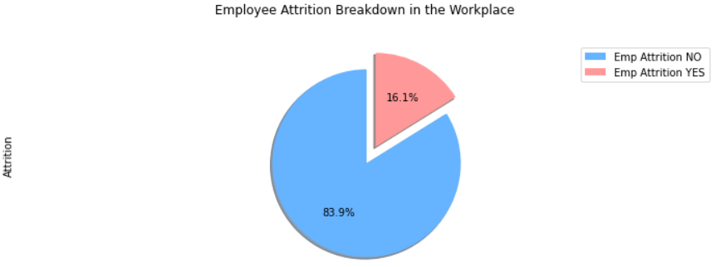
Distribution of the employee attrition status of a company from the chosen dataset with the help of pie chart

Slide 10
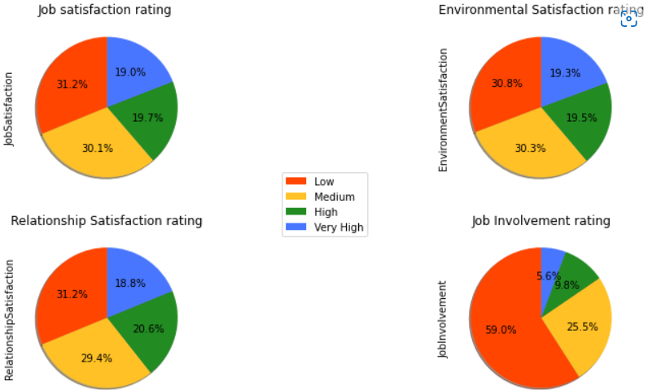
Dataset features distribution
According to the subplots, just approximately 40% of employees are:
• Satisfied with their Job
• Satisfied with their Work Environment
• Satisfied with their Relationship
• Getting Involved in their Job
As a result, nearly the remaining 60% of employees are dissatisfied with the aforementioned limits.

Slide 11
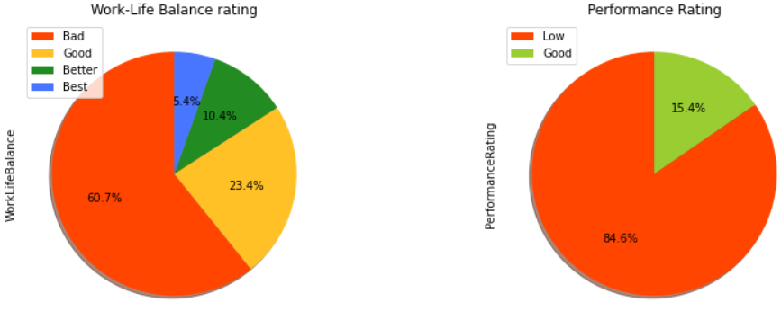
Pie Chart representing Work-life balance and Performance rating
Furthermore, the pie charts below show that
• about 60% of employees regard their work-life balance as poor.
• Nearly 85% of employees have a bad performance rating,
Indicating that most employees are dissatisfied with their work-life balance and have a negative performance rating. As a result, this might be the obvious cause of the increased attrition rate.

Slide 12
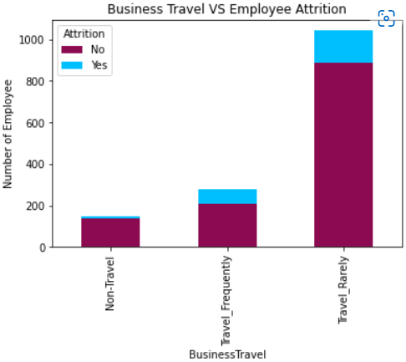
Analysis of Business Travel Feature
The employees who have the least attrition rate. As it could be seen in the bar chart from the maroon color. However, employees who have a history of traveling the most which can be seen from the blue color in the bar chart have highest chances of leaving the company.

Slide 13
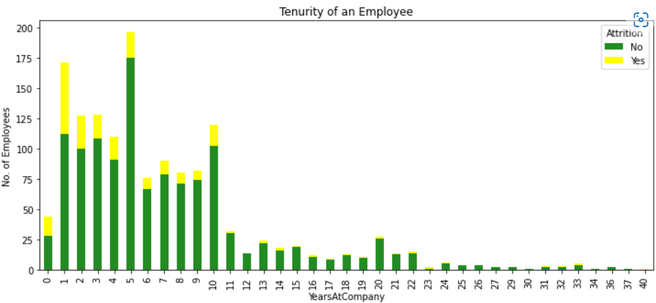
Analysis of Work Experience
The criteria listed below provide an examination of an employee's work experience. This also suggests that newcomers are quitting their employment too soon. Members with tenure experience reduced attrition rates. As a result, it is vital to pay special attention to the newly hired employee. Because there might be an issue that is causing them to leave. Such as the training committee's lack of competence, giving greater workload, and so on.
• YearsAtCompany
• YearsInCurrentRole
• YearsSinceLastPromotion
• YearsWithCurrManager
• TotalWorkingYears

Slide 14
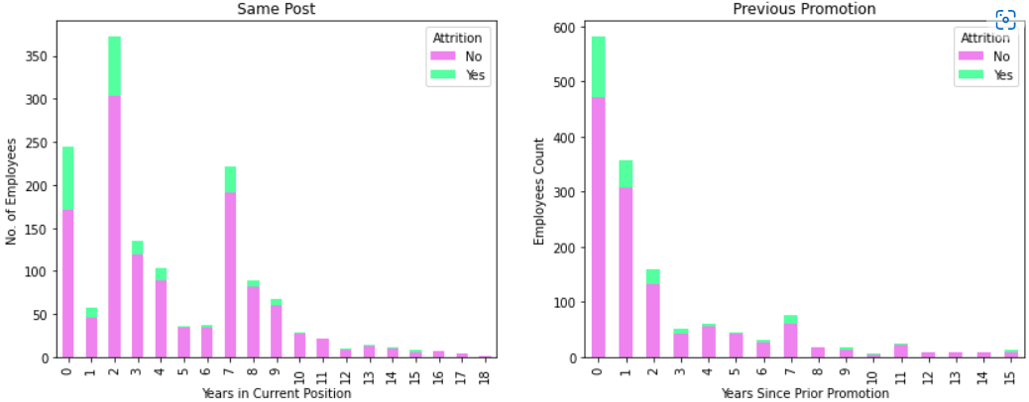
Total Employment period of an employee
The employees who have the least attrition rate. As it could be seen in the bar chart from the maroon color. However, employees who have a history of traveling the most which can be seen from the blue color in the bar chart have highest chances of leaving the company.

Slide 15
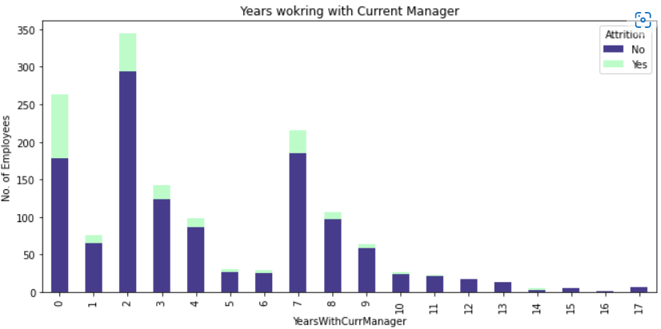
Working with current manager of an employee
AS DISCUSSED ABOVE THAT IT IS ESSENTIAL TO KNOW WHICH EXPERIENCE BRACKET GROUP EMPLOYEES ARE LIKELY TO BE QUITTING THE JOB. THUS, FROM THE BELOW BAR GRAPH IT COULD BE IDENTIFIED THAT EMPLOYEES WHO HAVE BEEN WORKING SINCE 1- 10 YEARS WILL BE MOST LIKELY QUITTINGF THE JOB.
THE BAR GRAPH FOR EMPLOYEE ATTRITION HAS SIGNIFICANTLY DROPPED FOR 11+ YEARS OF EMPLOYEE TENURE IN THAT COMPANY. AND THE GRAPH CONSTANTLY WENT ON DECREASING TILL THE AGE 40 OF AN EMPLOYEE. LIKE THIS IT IS ESSENTIAL TO TAKE INTO CONSIDERATION ALL THE TRENDS FROM THE FEATURES OF A DATASET.

Slide 16
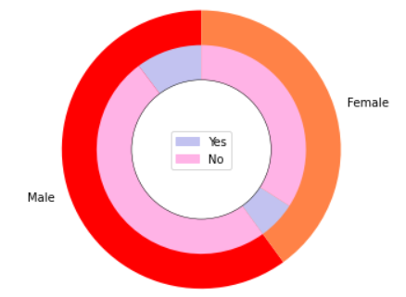
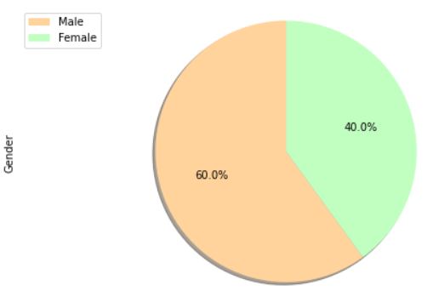
Gender Analysis
According to the pie charts, 60% of the employees are male and 40% are female. The lavender section implies attrition, but the pink part indicates no attrition. So, based on the pie chart below, we may conclude that male employees have a little greater turnover rate than female employees. It is not necessary that the if the male employees are more in proportion, then they should be having the high attrition rate. But there are more probability if we compare the ratio of the 2 genders which is 60:40

Slide 17

MODELING
The research takes use of the most popular and commonly used Python libraries. The following are the libraries that are utilized in the project.
• Pandas is a library for managing data frames.
• Numpy - If any mathematical or statistical models are used in a study, Numpy is a must-have library.
• Matplotlib is a Python and NumPy cross-platform data visualization and graphical charting library.
• The variables train test split and train test split split split split split split split s

Slide 18
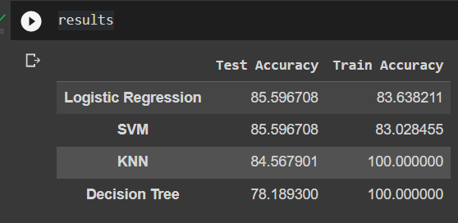
EVALUATION
According to the results, Decision Tree and KNN provided 100% train correctness. SVM, on the other hand, provided a respectable train accuracy score of 83.02%.In terms of training accuracy, it was discovered that SVM and Logistic Regression offered 83% accuracy. In terms of test accuracy, Decision Tree had the lowest accuracy of 78.18%, followed by KNN at 84.56%. SVM and Logistic Regression both achieved test scores of 85.59%.

Slide 19
DEPLOYMENT
The study's goals were to determine the best forecasting approach for employee attrition. Four algorithms where tested SVM, KNN, Decision Tree, & Logistic Regression Finally, it was discovered that Logistic Regression and SVM had the greatest test accuracy of 85.96%, which is consistent with the findings of most previous studies.

Slide 20

Thank You

